Slide 1
Team-1 AquaPredict App
Problem Statement:
Water Quality from Mobile captured and Google earth images.
Problem Description:
Color of the water is result of solar radiation interaction with water constituents and its concentration. The changing watercolor is direct indicator of changing water parameters and its suitability of usage. Measurement of water leaving radiance in visible region and its transformation to hue angle do provide necessary water parameters. Development of App for measurement of Water Quality using smartphone.
Department of India space and research organization , (ISRO)
Disaster management (SS596)
Innovation is the spirit of life !

Slide 2
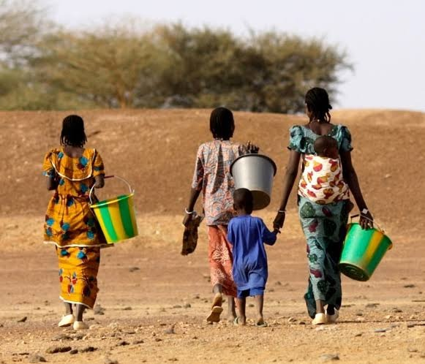
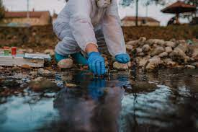
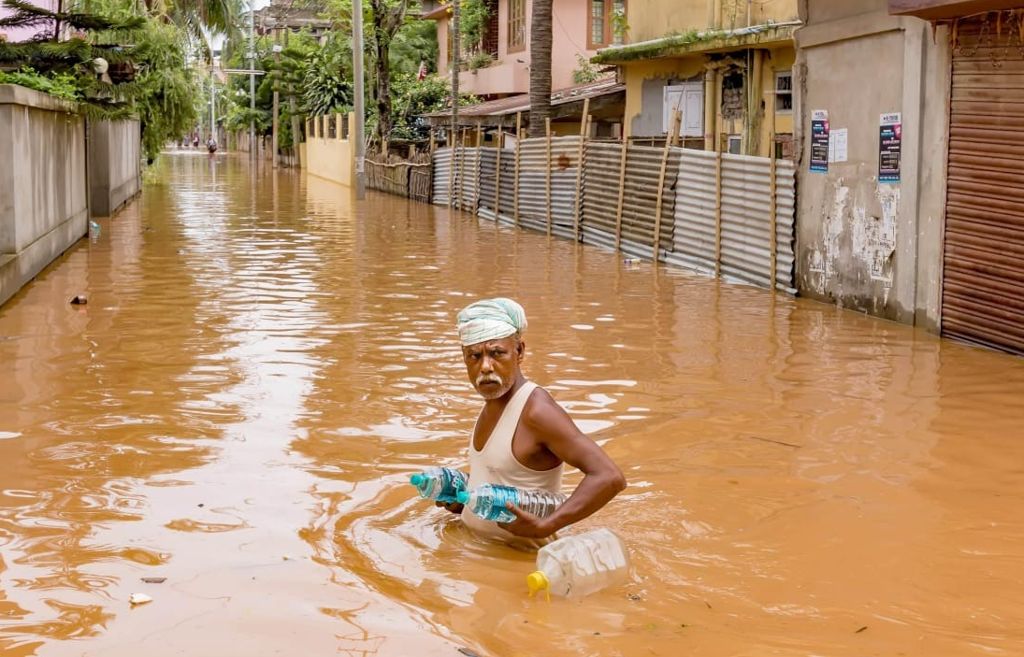

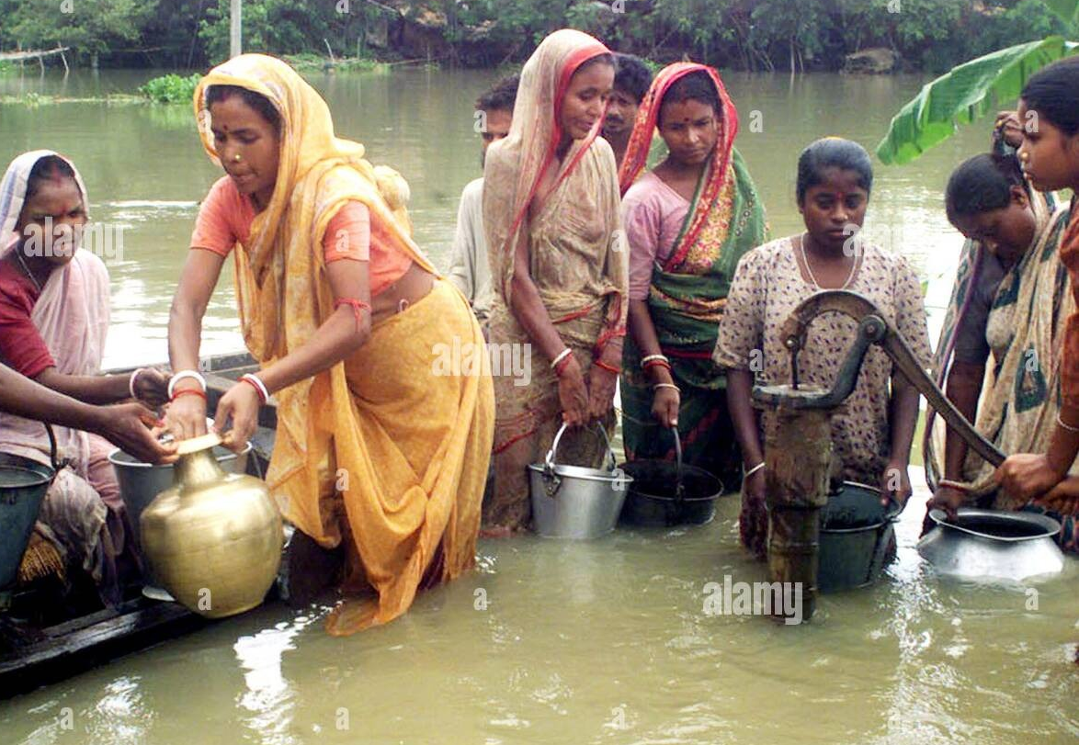
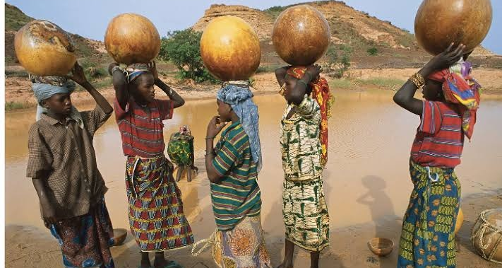
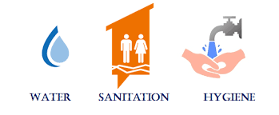
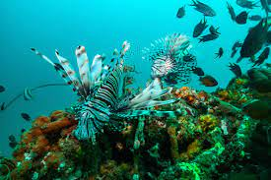
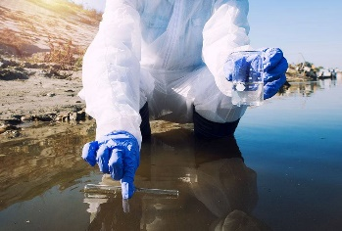

Necessity ? (S01 &SO4)
Identifying nearby potable water sources under unusual situations like hazards and disasters (i.e., flood and drought ).
Catalyzing/Accelerating the process of testing and improving the quality of water sources. Large range of area coverage for inspection.
Predicting and preventing any unforeseen conditions (increasing radioactive content, toxicity, etc.) by regular check on purity of water.
Aids Government schemes (i.e. Jal Shakti, Jal Jeevan and Government’s Clean India movement.) by developing improved water quality monitoring systems and strengthening the operation and maintenance of water supply infrastructures.
Saving aquatic life and terrestrial animals depending on water body.

Slide 3
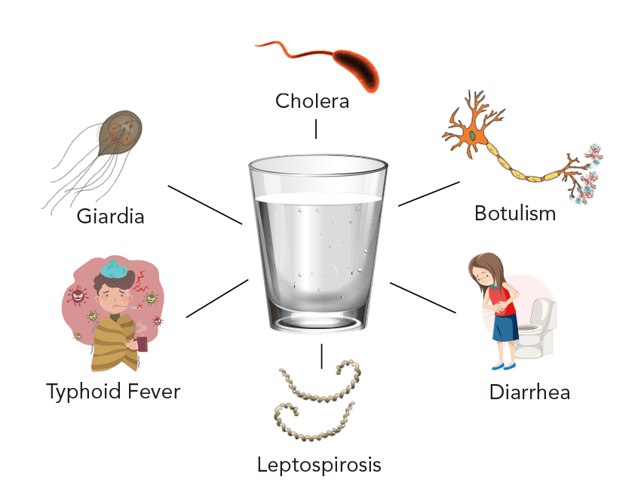
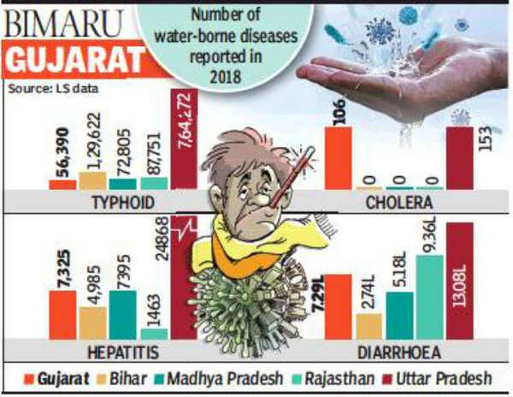
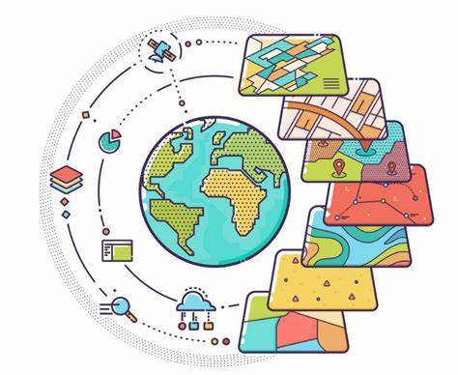
A safe water supply is the backbone of a healthy economy, yet is woefully prioritized, globally.
Waterborne diseases have an economic burden of approximately USD 600 million a year in India. This is especially true for drought- and flood-prone areas, which affected a third of the nation in the past couple of years.
According to the Ministry of Health, between Jan. 2014 to Sep. 2017 a total of 8,324 lives were lost due to water-borne diseases, which translates to one death every four hours.
Advancement in science & technology this problem can be minimized, and information can be.
https://timesofindia.indiatimes.com/city/ahmedabad/gujarat-more-bimar-than-bimaru-states-in-water-borne-diseases/articleshow/70441988.cms

Slide 4
Idea Description (SO2)
We Developed a mobile application that can predict water quality from satellite images and Mobile clicked images. For satellite images we used the band values of images to extract water quality parameters like pH, turbidity, SPM, CDOM etc. We are using Google Earth engine to calculate Band values of images. For Mobile clicked images we are calculating hue angle and FUI Scale and then correlating them with water quality parameters like turbidity. At last, we are classifying the water based on its Designated use.

Slide 5
Objectives
To develop an algorithm for classification of water based on designated use using optically active parameters like SPM, EC etc.
To derive correlations between indices and parameters pertaining to water quality from Band values and RGB values.
Integrating these into an an efficient, user-friendly smartphone application to identify water quality either from satellite image search or from clicked photographs of the water body.

Slide 6
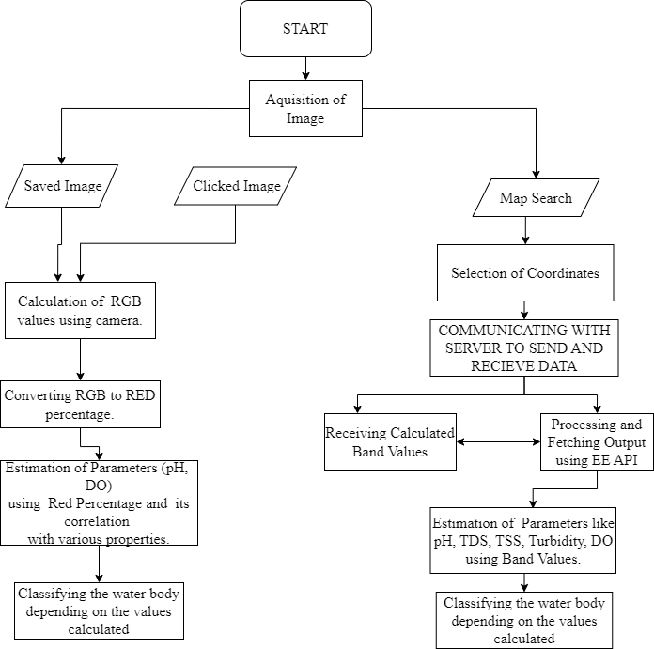
Methodology and flow

Slide 7
Classification of water

Slide 8
Result and discussion

Slide 9
Punjab water sources
Punjab is a northwestern State in India, bordering Pakistan to the west. It was at the forefront of India’s green revolution, which drove economic growth during the sixties and the seventies, and made It is one of India's most prosperous and developed states. Intensive agricultural production was driven by the predominantly flat topography, fertile alluvial soils, a long-standing policy of free electricity, and plentiful surface and groundwater resources that resulted in a large net area being dedicated to agriculture, and almost all of that area being irrigated. Surface water irrigation is from five tributaries of the Indus: Jhelum, Chenab, Ravi, Sutlej, and Beas, from which the State derives its name, and about 1.25 million tubewells.

Slide 10
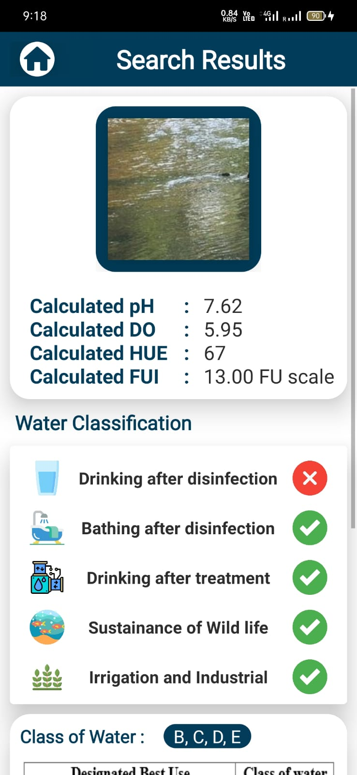
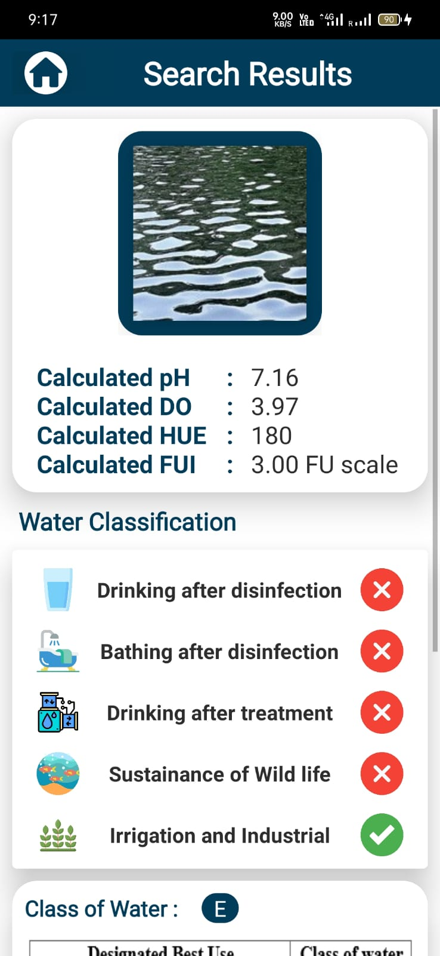
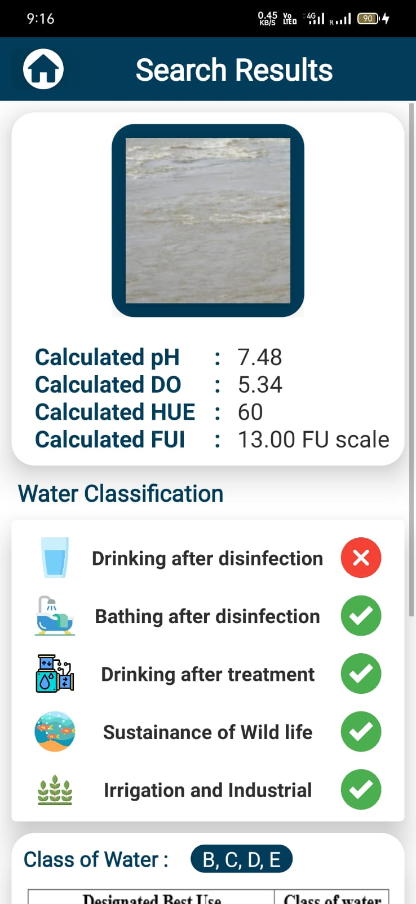
Spatio-temporal Evaluation of Results (SO6)

Slide 11
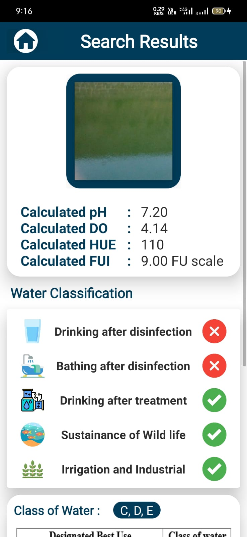
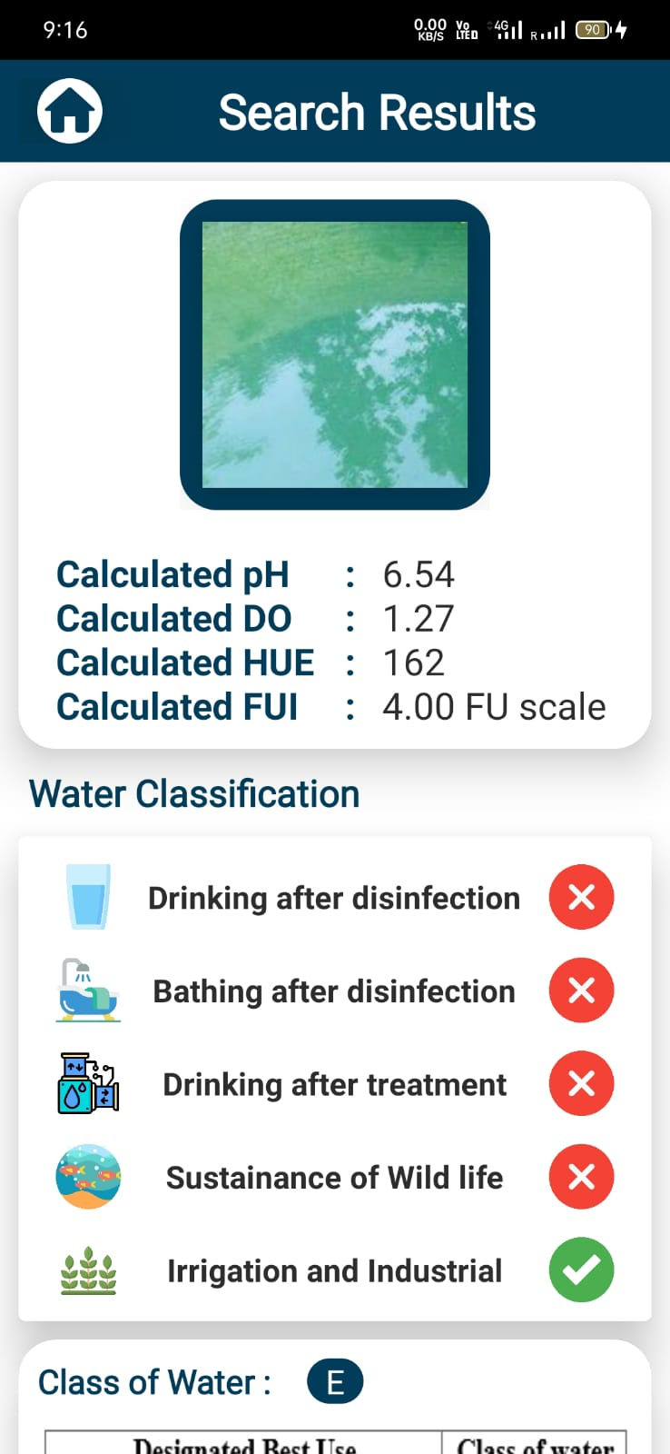

Slide 12
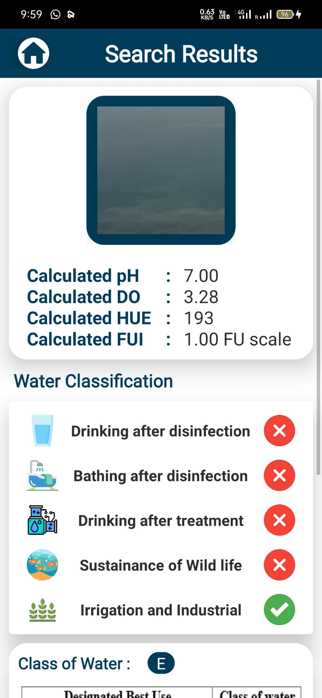
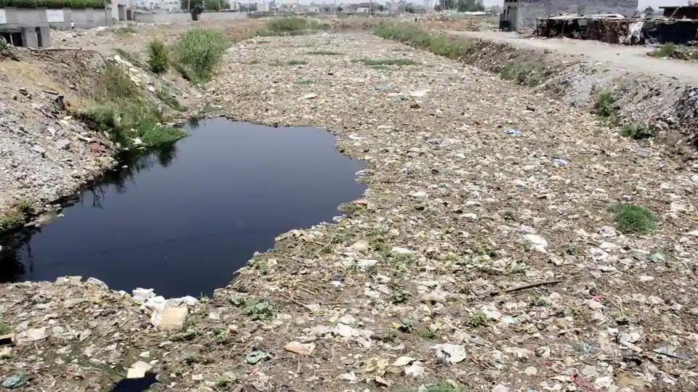
Budha Nala, Punjab

Slide 13
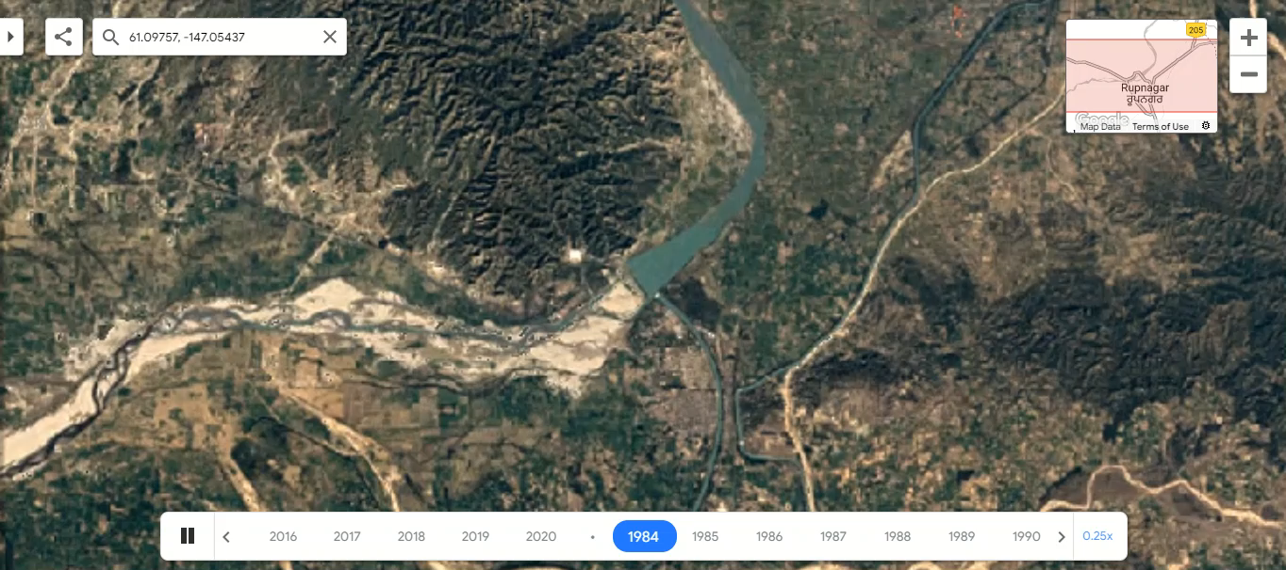
Satluj (Google Time-lapse)

Slide 14
Advantages
Water quality inspection on just few clicks, saves a lot of time, resources and man power enabling cost savings from proactive versus reactive responses.
Acquisition and analysis of data on regular basis
Can monitor a large scale area.
More up-to-date public safety information that is useful to fishermen, sailors, tourists, general public, and public water system managers.

Slide 15
Future Work
Can be upgraded by implementing the feedback testing mechanism.
Upgraded to near real time water quality prediction.
Fore coming water hazards from natural or foreign entities can be predicted, analyzed and handled in a effective manner.
For analysis of spatial and temporal variability of water sources.
Inclusion of a water identification algorithm in our application through which we can detect the that presence of water in any Clicked image Search which will help in making our system more time and performance efficient
New techniques have to studied and implemented for deriving additional parameters from satellite (i.e., Sentinal-2) for characterization of quality of water and from RGB values of images and it should be validated with proper research and analyses on different water samples.

Slide 16
Outcomes
Participated and Won in “SIH 2022” under the Disaster Management Category conducted by SAC-ISRO.
It is published as a book chapter for an edited volume, titled “Advanced Communication and Intelligent Systems” in the Springer Book Series “Communications in Computer and Information Science”. https://www.springer.com/series/7899

Slide 17
Thank You!

